Slide 1
Chapter 14
How to create and use objects

Slide 2
Applied objectives
Create and use your own classes, objects, properties, and methods.
Create and use your own class constants, static properties, and static methods.
Use your own classes and objects to implement the MVC pattern.

Slide 3
Knowledge objectives
Describe the creation of a class including its properties and methods.
Describe the use of the $this variable in a class.
Describe the creation of an object from a class and the use of the object’s properties and methods.
Describe the use of class constants and static properties and methods.
Describe the differences between applications that use procedural techniques for implementing the MVC pattern and those that use object-oriented techniques.
Describe how inheritance works.

Slide 4
The Category class
class Category {
private $id;
private $name;
public function __construct($id, $name) {
$this->id = $id;
$this->name = $name;
}
public function getID() {
return $this->id;
}
public function setID($value) {
$this->id = $value;
}
public function getName() {
return $this->name;
}
public function setName($value) {
$this->name = $value;
}
}

Slide 5
Key terms related to object-oriented programming
object-oriented programming
class
object
property
method

Slide 6
The Product class (part 1)
class Product {
private $category, $id, $code, $name, $price;
public function __construct(
$category, $code, $name, $price) {
$this->category = $category;
$this->code = $code;
$this->name = $name;
$this->price = $price;
}

Slide 7
The Product class (part 2)
public function getCategory() {
return $this->category;
}
public function setCategory($value) {
$this->category = $value;
}
public function getID() {
return $this->id;
}
public function setID($value) {
$this->id = $value;
}

Slide 8
The Product class (part 3)
public function getCode() {
return $this->code;
}
public function setCode($value) {
$this->code = $value;
}
public function getName() {
return $this->name;
}
public function setName($value) {
$this->name = $value;
}

Slide 9
The Product class (part 4)
public function getPrice() {
return $this->price;
}
public function getPriceFormatted() {
$formatted_price =
number_format($this->price, 2);
return $formatted_price;
}
public function setPrice($value) {
$this->price = $value;
}

Slide 10
The Product class (part 5)
public function getDiscountPercent() {
$discount_percent = 30;
return $discount_percent;
}
public function getDiscountAmount() {
$discount_percent =
$this->getDiscountPercent()/ 100;
$discount_amount = $this->price * $discount_percent;
$discount_amount_r = round($discount_amount, 2);
$discount_amount_f =
number_format($discount_amount_r, 2);
return $discount_amount_f;
}

Slide 11
The Product class (part 6)
public function getDiscountPrice() {
$discount_price =
$this->price - $this->getDiscountAmount();
$discount_price_f =
number_format($discount_price, 2);
return $discount_price_f;
}

Slide 12
The Product class (part 7)
public function getImageFilename() {
$image_filename = $this->code . '.png';
return $image_filename;
}
public function getImagePath() {
$image_path =
'../images/' . $this->getImageFilename();
return $image_path;
}
public function getImageAltText() {
$image_alt =
'Image: ' . $this->getImageFilename();
return $image_alt;
}
}

Slide 13
The syntax for coding a property
[ public | protected | private ] $propertyName
[ = initialValue ];
A private property
private $firstName;
A public property with a default value
public $comment = '';
A protected property
protected $counter;
Five properties on the same line
private $category, $id, $name, $description, $price;

Slide 14
Key terms related to properties
public property
private property
protected property
scalar value

Slide 15
The syntax for coding a constructor method
public function __construct([parameterList]) {
// Statements to execute
}
The default constructor
public function __construct() { }
The constructor for the Category class
public function __construct($id, $name) {
$this->id = $id;
$this->name = $name;
}
The constructor with default values
public function __construct($id = NULL, $name = NULL) {
$this->id = $id;
$this->name = $name;
}

Slide 16
How to code a destructor method
The syntax
public function __destruct() {
// Statements to execute
}
A destructor for a database class
public function __destruct() {
$this->dbConnection->close();
}

Slide 17
Key terms related to constructors and destructors
constructor method
constructor
destructor method
destructor
object access operator

Slide 18
The syntax for coding a method
[public | private | protected]
function functionName ([parameterList]) {
// Statements to execute
}
A public method
public function getSummary() {
$maxLength = 25;
$summary = $this->description;
if (strlen($summary) > $maxLength) {
$summary =
substr($summary, 0, $maxLength - 3) . '...';
}
return $summary;
}

Slide 19
A private method
private function internationalizePrice($country = 'US') {
switch ($country) {
case 'US':
return '$' . number_format($this->price, 2);
case 'FR':
return number_format(
$this->price, 2, ',' , '.') . ' EUR';
default:
return number_format($this->price, 2);
}
}

Slide 20
A method that accesses a property of the current object
public function showDescription() {
echo $this->description;
}
A method that calls a method of the current object
public function showPrice($country = 'US') {
echo $this->internationalizePrice($country);
}

Slide 21
The syntax for creating an object
$objectName = new ClassName(argumentList);
Creating a Category object
$brass = new Category(4, 'Brass');
Creating a Product object
$trumpet = new Product($brass,
'Getzen',
'Getzen 700SP Trumpet',
999.95);

Slide 22
The syntax for setting a public property value
$objectName->propertyName = value;
The syntax for getting a public property value
$objectName->propertyName;
Setting a property
$trumpet->comment = 'Discontinued';
Getting a property
echo $trumpet->comment;

Slide 23
The syntax for calling an object’s methods
$objectName->methodName(argumentList);
Calling the getFormattedPrice() method
$price = $trumpet->getFormattedPrice();
Object chaining
echo $trumpet->getCategory()->getName();

Slide 24
Key terms for creating objects
instance of a class
instantiation
object chaining

Slide 25
A class with three class constants
class Person {
const GREEN_EYES = 1;
const BLUE_EYES = 2;
const BROWN_EYES = 3;
private $eye_color;
public function getEyeColor() {
return $this->eye_color;
}
public function setEyeColor($value) {
if ($value == self::GREEN_EYES ||
$value == self::BLUE_EYES ||
$value == self::BROWN_EYES) {
$this->eye_color = $value;
} else {
exit('Eye Color Not Set');
}
}
}

Slide 26
Using a constant outside the class
$person = new Person();
$person->setEyeColor(Person::GREEN_EYES);

Slide 27
A class with a static property and method
class Category {
private $id, $name;
private static $objectCount = 0;
// declare a static property
public function __construct($id, $name) {
$this->id = $id;
$this->name = $name;
self::$objectCount++;
// update the static property
}
// A public method that gets the static property
public static function getObjectCount(){
return self::$objectCount;
}
// The rest of the methods for the Category class
}

Slide 28
Using a public static method
$guitars = new Category(1, 'Guitars');
$basses = new Category(2, 'Basses');
echo '<p>Object count: ' .
Category::getObjectCount() . '</p>'; // 2
$drums = new Category(3, 'Drums');
echo '<p>Object count: ' .
Category::getObjectCount() . '</p>'; // 3
Using a public static property
echo '<p>Object count: ' .
Category::$objectCount . '</p>';

Slide 29
Key terms related to class definitions
class constant
scope resolution operator
static property
static method
class property
class method

Slide 30
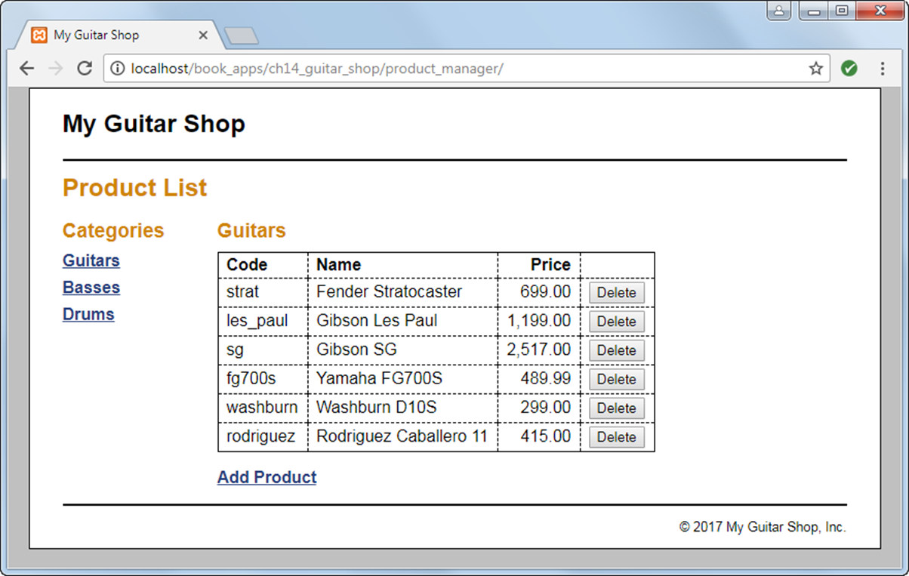
The Product List page

Slide 31
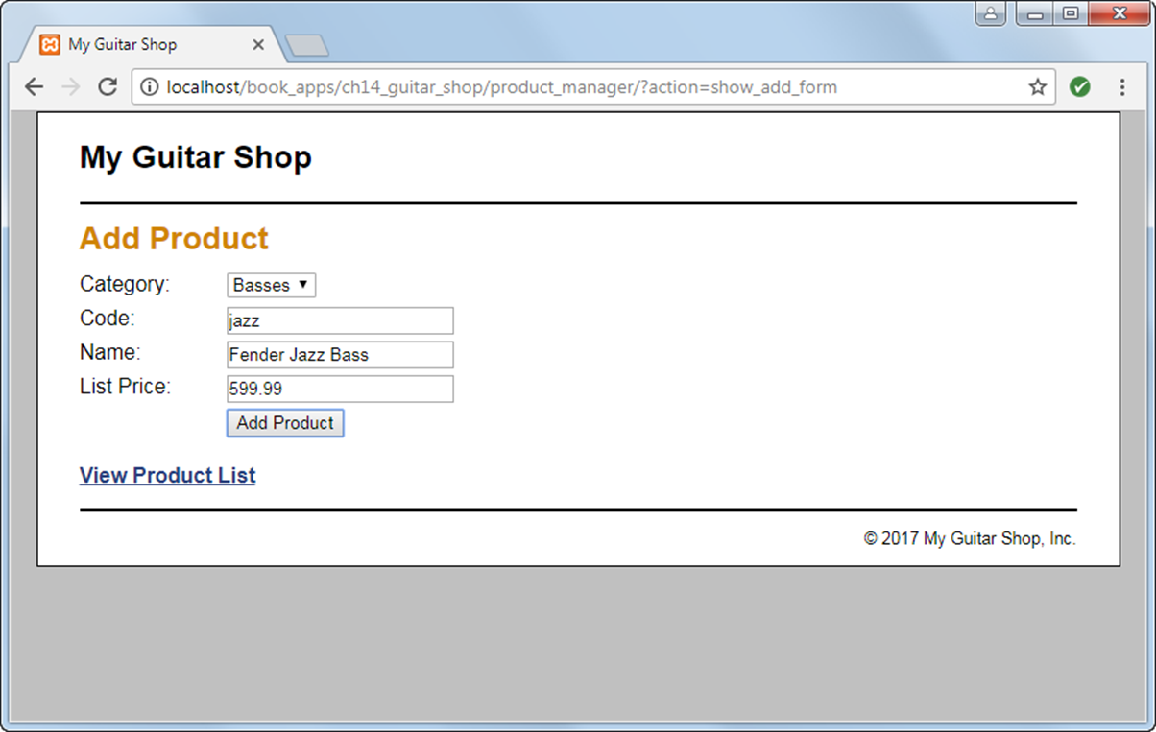
The Add Product page

Slide 32
The database.php file (part 1)
<?php
class Database {
private static $dsn =
'mysql:host=localhost;dbname=my_guitar_shop1';
private static $username = 'mgs_user';
private static $password = 'pa55word';
private static $db;
private function __construct() {}

Slide 33
The database.php file (part 2)
public static function getDB() {
if (!isset(self::$db)) {
try {
self::$db = new PDO(self::$dsn,
self::$username,
self::$password);
} catch (PDOException $e) {
$error_message = $e->getMessage();
include('../errors/database_error.php');
exit();
}
}
return self::$db;
}
}
?>

Slide 34
The product_db.php file (part 1)
<?php
class ProductDB {
public static function getProductsByCategory($category_id) {
$db = Database::getDB();
$category = CategoryDB::getCategory($category_id);
$query = 'SELECT * FROM products
WHERE products.categoryID = :category_id
ORDER BY productID';
$statement = $db->prepare($query);
$statement->bindValue(":category_id", $category_id);
$statement->execute();
$rows = $statement->fetchAll();
$statement->closeCursor();
foreach ($rows as $row) {
$product = new Product($category,
$row['productCode'],
$row['productName'],
$row['listPrice']);
$product->setId($row['productID']);
$products[] = $product;
}
return $products;
}

Slide 35
The product_db.php file (part 2)
public static function getProduct($product_id) {
$db = Database::getDB();
$query = 'SELECT * FROM products
WHERE productID = :product_id';
$statement = $db->prepare($query);
$statement->bindValue(":product_id", $product_id);
$statement->execute();
$row = $statement->fetch();
$statement->closeCursor();
$category = CategoryDB::getCategory($row['categoryID']);
$product = new Product($category,
$row['productCode'],
$row['productName'],
$row['listPrice']);
$product->setID($row['productID']);
return $product;
}

Slide 36
The product_db.php file (part 3)
public static function deleteProduct($product_id) {
$db = Database::getDB();
$query = 'DELETE FROM products
WHERE productID = :product_id';
$statement = $db->prepare($query);
$statement->bindValue(':product_id', $product_id);
$statement->execute();
$statement->closeCursor();
}

Slide 37
The product_db.php file (part 4)
public static function addProduct($product) {
$db = Database::getDB();
$category_id = $product->getCategory()->getID();
$code = $product->getCode();
$name = $product->getName();
$price = $product->getPrice();
$query = 'INSERT INTO products
(categoryID, productCode, productName,
listPrice)
VALUES
(:category_id, :code, :name, :price)';
$statement = $db->prepare($query);
$statement->bindValue(':category_id', $category_id);
$statement->bindValue(':code', $code);
$statement->bindValue(':name', $name);
$statement->bindValue(':price', $price);
$statement->execute();
$statement->closeCursor();
}
}
?>

Slide 38
The index.php file (part 1)
<?php
require('../model/database.php');
require('../model/category.php');
require('../model/category_db.php');
require('../model/product.php');
require('../model/product_db.php');
$action = filter_input(INPUT_POST, 'action');
if ($action == NULL) {
$action = filter_input(INPUT_GET, 'action');
if ($action == NULL) {
$action = 'list_products';
}
}

Slide 39
The index.php file (part 2)
if ($action == 'list_products') {
$category_id = filter_input(INPUT_GET, 'category_id',
FILTER_VALIDATE_INT);
if ($category_id == NULL || $category_id == FALSE) {
$category_id = 1;
}
$current_category = CategoryDB::getCategory($category_id);
$categories = CategoryDB::getCategories();
$products = ProductDB::getProductsByCategory($category_id);
include('product_list.php');
} else if ($action == 'delete_product') {
$product_id = filter_input(INPUT_POST, 'product_id',
FILTER_VALIDATE_INT);
$category_id = filter_input(INPUT_POST, 'category_id',
FILTER_VALIDATE_INT);
ProductDB::deleteProduct($product_id);
header("Location: .?category_id=$category_id");
} else if ($action == 'show_add_form') {
$categories = CategoryDB::getCategories();
include('product_add.php');

Slide 40
The index.php file (part 3)
} else if ($action == 'add_product') {
$category_id = filter_input(INPUT_POST, 'category_id',
FILTER_VALIDATE_INT);
$code = filter_input(INPUT_POST, 'code');
$name = filter_input(INPUT_POST, 'name');
$price = filter_input(INPUT_POST, 'price');
if ($category_id == NULL || $category_id == FALSE ||
$code == NULL ||
$name == NULL || $price == NULL || $price == FALSE) {
$error = "Invalid product data. Check all fields and try
again.";
include('../errors/error.php');
} else {
$category = CategoryDB::getCategory($category_id);
$product = new Product($category, $code, $name, $price);
ProductDB::addProduct($product);
header("Location: .?category_id=$category_id");
}
}
?>

Slide 41
The product_list.php file (part 1)
<?php include '../view/header.php'; ?>
<main>
<h1>Product List</h1>
<aside>
<!-- display a list of categories -->
<h2>Categories</h2>
<nav>
<ul>
<?php foreach ($categories as $category) : ?>
<li>
<a href="?category_id=<?php echo $category->getID(); ?>">
<?php echo $category->getName(); ?>
</a>
</li>
<?php endforeach; ?>
</ul>
</nav>
</aside>

Slide 42
The product_list.php file (part 2)
<section>
<!-- display a table of products -->
<h2><?php echo $current_category->getName(); ?></h2>
<table>
<tr>
<th>Code</th>
<th>Name</th>
<th class="right">Price</th>
<th>&nbsp;</th>
</tr>

Slide 43
The product_list.php file (part 3)
<?php foreach ($products as $product) : ?>
<tr>
<td><?php echo $product->getCode(); ?></td>
<td><?php echo $product->getName(); ?></td>
<td class="right"><?php echo
$product->getPriceFormatted(); ?>
</td>
<td><form action="." method="post"
id="delete_product_form">
<input type="hidden" name="action"
value="delete_product">
<input type="hidden" name="product_id"
value="<?php echo $product->getID(); ?>">
<input type="hidden" name="category_id"
value="<?php echo
$current_category->getID(); ?>">
<input type="submit" value="Delete">
</form></td>
</tr>
<?php endforeach; ?>
</table>

Slide 44
The product_list.php file (part 4)
<p><a href="?action=show_add_form">Add Product</a></p>
</section>
</main>
<?php include '../view/footer.php'; ?>

Slide 45
The syntax for looping through an object’s properties
foreach($objectName as
[ $propertyName => ] $propertyValue) {
// statements to execute
}

Slide 46
An Employee class
class Employee {
public $firstName, $lastName;
private $ssn, $dob;
public function __construct($first, $last) {
$this->firstName = $first;
$this->lastName = $last;
}
// getSSN, setSSN, getDOB, setDOB methods not shown
// Show properties – private, protected, and public
public function showAll() {
echo '<ul>';
foreach($this as $name => $value ) {
echo "<li>$name = $value</li>";
}
echo '</ul>';
}
}

Slide 47
An Employee object with four properties
$employee = new Employee('John', 'Doe');
$employee->setSSN('999-14-3456');
$employee->setDOB('3-15-1970');
Show all properties
$employee->showAll();
Show public properties only
echo '<ul>';
foreach($employee as $name => $value ) {
echo "<li>$name = $value</li>";
}
echo '</ul>';

Slide 48
The syntax for cloning an object
clone $objectName
An object to clone
$brass = new Category(4, 'Brass');
$trumpet = new Product($brass,
'Getzen', 'Getzen 700SP Trumpet', 999.95);
Create a second reference to the object
$trombone = $trumpet;
// both variables refer to the same object
$trombone->setPrice(699.95);
// changes the price for both variables

Slide 49
Create a clone of the object
$trombone = clone $trumpet;
// copy the object
$trombone->setPrice(899.95);
// only changes the price for trombone
The copies are shallow copies
$trombone->getCategory()->setName('Orchestral Brass');
echo $trumpet->getCategory()->getName();
// Displays 'Orchestral Brass'

Slide 50
Using the == operator to compare objects
$result_1 = ($trumpet == $trombone);
// $result_1 is FALSE
$flugelhorn = clone $trumpet;
$result_2 = ($trumpet == $flugelhorn);
// $result_2 is TRUE
Using the === operator to compare objects
$result_3 = ($trumpet === $flugelhorn);
// $result_3 is FALSE
$trumpet_2 = $trumpet;
$result_4 = ($trumpet === $trumpet_2);
// $result_4 is TRUE
$result_5 = ($trumpet->getCategory() ===
$trombone->getCategory());
// $result_5 is TRUE

Slide 51
Key terms related to cloning objects
clone
shallow copy

Slide 52
Functions for inspecting an object
class_exists($class)
get_class($object)
is_a($object, $class)
property_exists($object, $property)
method_exists($object, $method)

Slide 53
Determine if an object is an instance of a class
if (is_a($trumpet, 'Product')) {
// Code to work with a Product object
}
Determine if an object has a property
if (property_exists($trumpet, 'price')) {
// Code to work with the price property
}
Determine if an object has a method
if (method_exists($trumpet, 'getPrice')) {
// Code to work with the getPrice method
}

Slide 54
Key terms for inspecting an object
introspection
reflection

Slide 55
A superclass (part 1)
class Person {
private $firstName, $lastName, $phone, $email;
public function __construct($first, $last) {
$this->firstName = $first;
$this->lastName = $last;
}
public function getFirstName()
{ return $this->firstName; }
public function setFirstName($value)
{ $this->firstName = $value; }
public function getLastName()
{ return $this->lastName; }
public function setLastName($value)
{ $this->lastName = $value; }
public function getPhone()
{ return $this->phone; }
public function setPhone($value)
{ $this->phone = $value; }

Slide 56
A superclass (part 2)
public function getEmail()
{ return $this->email; }
public function setEmail($value)
{ $this->email = $value; }
}

Slide 57
A subclass
class Employee extends Person {
private $ssn, $hireDate;
public function __construct(
$first, $last, $ssn, $hireDate) {
$this->ssn = $ssn;
$this->hireDate = $hireDate;
// Finish initialization
parent::__construct($first, $last);
}
public function getSSN()
{ return $this->ssn; }
public function setSSN($value)
{ $this->ssn = $value; }
public function getHireDate()
{ return $this->hireDate; }
public function setHireDate($value)
{ $this->hireDate = $value; }
}

Slide 58
Code that uses the subclass
$emp = new Employee(
'John', 'Doe', '999-14-3456', '8-25-1996');
$emp->setPhone('919-555-4321');
// Inherited from Person Class

Slide 59
Key terms related to inheritance
inheritance
inherit
subclass, derived class, child class
superclass, base class, parent class
extend a superclass
override a method of a superclass

Slide 60
How the access modifiers work
Modifier Access outside class? Access from subclass?
public Yes Yes
protected No Yes
private No No

Slide 61
A superclass
class Person {
protected $firstName, $lastName;
private $phone, $email;
// get and set methods
}
A subclass
class Employee extends Person {
private $ssn, $hireDate;
// get and set methods same as in Employee class
// Using the protected properties
// from the Person class
public function getFullName() {
return $this->lastName . ', ' .
$this->firstName;
}
}

Slide 62
An abstract class with an abstract method
abstract class Person {
private $firstName, $lastName, $phone, $email;
// get and set methods
// An abstract method
abstract public function getFullName();
}

Slide 63
Implementing an abstract class (part 1)
class Customer extends Person {
private $cardNumber, $cardType;
public function __construct(
$first, $last, $phone, $email) {
$this->setPhone($phone);
$this->setEmail($email);
parent::__construct($first, $last);
}
public function getCardNumber()
{ return $this->cardNumber; }
public function setCardNumber($value)
{ $this->cardNumber = $value; }
public function getCardType()
{ return $this->cardType; }
public function setCardType($value)
{ $this->cardType = $value; }

Slide 64
Implementing an abstract (part 2)
// Concrete implementation of the abstract method
public function getFullName() {
return $this->getFirstName() . ' ' .
$this->getLastName();
}
}

Slide 65
Code that attempts to create an object from the abstract class
$customer = new Person('John', 'Doe');
// Fatal error
Code that creates and uses an object from the concrete class
$customer = new Customer(
'John', 'Doe', '919-555-4321', 'jdoe@example.com');
echo '<p>' . $customer->getFullName() . '</p>';

Slide 66
Key terms related to abstract classes
abstract class
abstract method
concrete class

Slide 67
A class with a final method
class Person {
// Other properties and methods not shown here
final public function getFirstName() {
return $this->firstName;
}
}
A subclass that tries to override the final method
class Employee extends Person {
// Other properties and methods not shown here
// Attempt to override a final method - fatal error
public function getFirstName() {
return ucwords($this->firstName);
}
}

Slide 68
A final class that can’t be inherited
final class Employee extends Person {
// Properties and methods for class
}
A class that attempts to inherit the final class
class PartTime extends Employee {
// Properties and methods for class
}

Slide 69
The syntax for creating an interface
interface interfaceName {
const constantName = constantValue;
public function methodName( parameterList );
}
An interface to show an object
interface Showable {
public function show();
}
An interface that requires two test methods
interface Testable {
public function test1($value1);
public function test2($value1, $value2);
}

Slide 70
An interface that provides three constants
interface EyeColor {
const GREEN = 1;
const BLUE = 2;
const BROWN = 3;
}

Slide 71
A class that inherits a class and implements an interface
class Employee extends Person implements Showable {
// get and set methods
// Implement the Showable interface
public function show() {
echo 'First Name: ' .
$this->getFirstName() . '<br>';
echo 'Last Name: ' .
$this->getLastName() . '<br>';
echo 'SSN: ' .
$this->ssn . '<br>';
echo 'Hire Date: ' .
$this->hireDate . '<br>';
}
}

Slide 72
A class declaration that implements three interfaces
class Customer extends Person
implements Showable,
Testable,
EyeColor { ... }

Slide 73
Key terms related to interfaces
interface
implementing an interface

